Slide 1


HB 1227
Court Readiness
Roadmap
Part of the HB 1227 Court Readiness Toolkit
Family & Youth Justice Programs – Administrative Office of the Courts Created January 2023

Slide 2
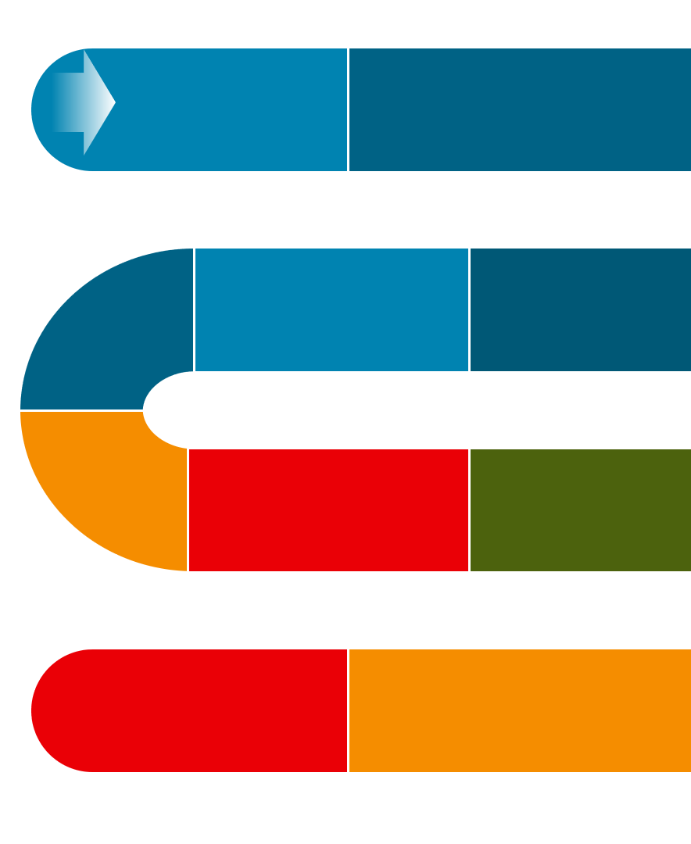
Instructions for Use
Gather a group of your dependency stakeholders.
This group could include different individuals from the Court, Judicial Officers, Clerk’s Office, CASA/GAL, Parent and Child representation, Office of Public Defense, Attorney Generals Office, DCYF and any others who play a role in your dependency court process from the start of a case through the first six months.
Take the HB 1227 Court Readiness Assessment with your group.
Help your court and stakeholders create a roadmap of their current processes. Include hearings, meetings between the parties, and major steps.
Review the results of the HB 1227 Readiness Assessment as a group to identify the areas in your roadmap in need of attention.
The HB 1227 Readiness Assessment will link you to further detail to lead these discussions.
Work through each identified section in the assessment that your group identified as an area that needs updating. Update your roadmap as you go. Use the Readiness Assessment and slides to help guide your discussions.
*If you have processes to update or create as you work through the slides, the last slide will help you start that process.

Slide 3
Slide Title
Shelter Care Hearing
Dependency Petition Filed
Continued Shelter Care Hearing
OUR CURRENT PROCESS
Fact Finding Hearing
First Dependency Review

Slide 4
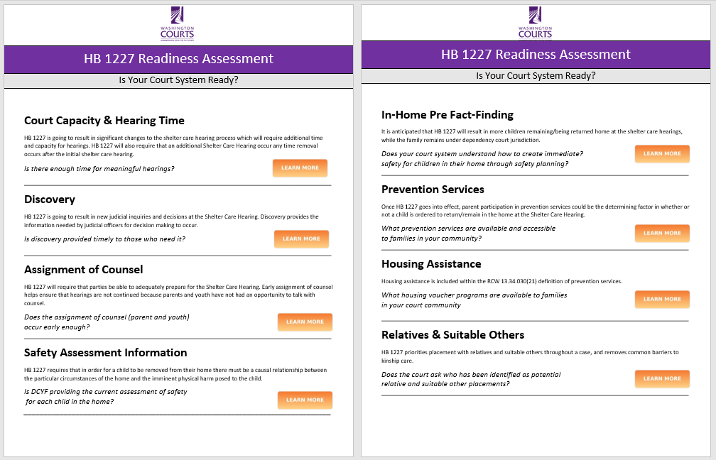
Review HB 1227 Readiness Assessment Results
1. Identify areas that need process improvement to be prepared for HB 1227. Reminder: select “Learn More”, for details on why this change is important, the connection to HB 1227, research, resources and recommendations to help guide your courts process improvement and questions to ask.
2. Lead cross-system process improvement meetings to work on each area of identified need using the following slides as a guide.

Slide 5
Slide Title
Dependency Petition Filed
Shelter Care Process
Shelter Care Hearing
Local court process that ensure timely notice, early discovery that includes safety assessments, assignment of counsel, and shared contact information to prepare for the Shelter Care hearing.
When a child is removed or when the petitioner is seeking removal, the court shall hold a shelter care hearing within 72 hours. The primary purpose of the hearing is to determine whether the child can be immediately and safely returned home or remain home while the adjudication of the dependency is pending. (link new RCW)
Contested Shelter Care
Causal relationship between the particular circumstances of the home and imminent physical harm posed to the child
Contesting placement or conditions for an in-home safety plan.
Services
Continued Shelter Care Hearing
Shelter Care Found
RCW 13.34.065 5(b)(ii): If the parent agrees to participate in the prevention services identified by the court that would prevent or eliminate the need for removal, the court shall place the child with the parent…
Case Conference
Shelter Care Not Found
Family Time, presumption of unsupervised. Review of the up to date safety assessment to overcome the presumption. Review the continued need for shelter care. RCW 13.34.065 (7)(a)(ii)
Child is placed out of home. Prioritization for relatives and suitable others. Services may be started/provided. RCW 13.34.065: Shelter care—Hearing—Recommendation as to further need—Release. (<i>Effective until July 1, 2023.</i>) (wa.gov)
Child returned or remains home, process continues
DCYF case conference, no later than 30 days prior to fact finding. Parties to create a service plan. RCW 13.34.067: Shelter care—Case conference—Service agreement. (wa.gov)
Overview of changes for HB 1227
Settlement Conference/ Negotiation/ Mediation for settlement
Fact Finding Hearing
Dependency Established
Disposition Hearing
Hearing or trial to determine if a child is dependent under RCW 13.34.030(6) Abandoned, abused, neglected, no parent, guardian or custodian capable .
RCW 13.34.130: Order of disposition for a dependent child, alternatives—Petition seeking termination of parent-child relationship—Placement with relatives, foster family home, group care facility, qualified residential treatment program, or other suitable persons—Placement of an Indian child in out-of-home care—Contact with siblings. (wa.gov)
Determine court ordered services, child in or out of home, if child is out of home, consider placement and family time.
Family Time
Continued review ensuring timely, least restrictive, frequent, consistent, and meaningful visits occur.
RCW 13.34.110: Hearings—Fact-finding and disposition—Time and place, notice. (wa.gov)
Placement
First Dependency Review
Additional Shelter Care Hearing
Continuing searches for relative and suitable others. Least restrictive.
Review of all factors in RCW… within 6 months from the beginning of the placement episode or no more than 90 days from the entry of the disposition order, whichever happens first.
If the child is placed in the home of the parent(s) and the child is removed, an additional shelter care hearing shall be held. RCW 13.34.065 (1)(a)
RCW 13.34.065: Shelter care—Hearing—Recommendation as to further need—Release. (<i>Effective until July 1, 2023.</i>) (wa.gov)
RCW 13.34.138: Review hearings—Findings—Duties of parties involved—In-home placement requirements—Housing assistance. (wa.gov)

Slide 6
Shelter Care Hearing: Court Capacity & Hearing Time
c
Is there enough time for meaningful hearings?
Questions to Consider
Research & Recommendations
On average, how many Shelter Care Hearings does your court hold per month?
On average, how long does your court currently spend on shelter care hearings?
How does your court currently structure the calendar to hear dependency cases?
Do you have regularly scheduled time for Shelter Care Hearings?
Does your court automatically set 30-Day Shelter Care Review hearings?
How is your court providing information to parents and children on how to access the Shelter Care Hearing (e.g., virtual attendance information)?
Is your court prepared to hold an additional shelter care hearing any time a child is removed during a case?
Does your calendar allow for enough time at Shelter Care Hearings to cover all needed information, including:
Contact FYJP about doing a Hearing Timing Study to assess the average amount of time spent on hearings Basic Court Timing Tool
Consider time-certain or block calendaring to build efficiency and capacity in your court’s docketing structure. Docket Management Infographic
Check out NCJFCJ Best Practices for Shelter Care Hearings
Build in time and space for attorneys to have conversations prior to the hearing with their clients and other professionals
Example: Shelter Care Hearings are scheduled 30-minutes prior to court actually starting. Professionals and parents show up to the courthouse and use this time to meet, negotiate, and determine if the hearing will be contested.
Rights
Notices
Attorney Assignment
Child Advocate Appointment
Testimony
Court Hearing Schedules
Reason to Know/ICWA Determination
Reasonable/Active Efforts Finding
Child Removal, Placement Decision
Family Time/Sibling Contact Orders
Educational Decisions
Medical Decisions

Slide 7
Contested Shelter Care Hearing:
Court Capacity & Hearing Time
c
Does our process allow enough hearing time for contested hearings to be held on the initial hearing date?
Questions to Consider
Research & Recommendations
Does our process and calendars allow enough time to have a robust contested hearing?
Is the court going to use a recording of the hearing or will a court reporter’s time be needed?
If contested hearings cannot be held on the initial date, how soon after the initial Shelter Care Hearings can contested hearings be scheduled?
Examples of commonly contested topics:
Notices
Reasonable & Active Efforts
Child Removal/Placement Decision
Family Time Visitation
Check out this research article: Hearing Quality in Child Abuse & Neglect Cases

Slide 8
Dependency Petition Filing: Emergency Removal Decisions
c
What is our court systems current practice around emergency child removal through ex parte orders, law enforcement custody, and hospital holds?
Questions to Consider
Is our court system and local child welfare system working with our local hospitals and law enforcement to ensure the new standard of imminent physical harm is understood?
What do our dependency petitions include?
Is there a statement as to whether DCYF is explicitly requesting the removal of a child?
Is there a clear and specific statement as to the harm that will occur to the child if they remain in the home?
Is there a statement regarding “Reason to Know” if the child is or may be an Indian child, in regards to both parents?
Are the names, residence, and contact information, if known, of each parent, guardian, or custodian of the alleged dependency child included?
What is our current process for parent notification?
Are parents being provided the dependency petition at the time of removal of the child?

Slide 9
Dependency Petition Filing: Early Notification Process
c
Does our notification process for a dependency petition filing provide enough time for the shelter care hearing to be meet the new standards and requirements set in HB 1227?
Questions to Consider
Research & Recommendations
How does early notification occur in your court system?
Who needs early notification of the dependency petition being filed?
Examples to discuss, Attorney assignor for the county, OPD, CASA/GAL 13.34.100(5), parent and children attorneys, court schedulers/clerks, parents, tribes, identified relatives that may be interested in placement or supporting the families, Parents for Parents.
When does notification need to be sent to the distribution list to ensure adequate time for parties to prepare for the shelter care hearing?
What information is included in early notification? Is there any information that should be included that is not already?
Examples of things to consider in early notification:
Placement Information: child placement information, type of placement, intent at shelter care for placement generic areas, not address. RCW 13.34.065(5)(j)(i)
Proposed shelter care orders
Parent and Child Attorney Assignments
Name of AAG assigned for the initial hearing.
Paternity/parentage concerns
CASA/GAL assignments
Parent contact information, if requested(ing) for incarcerated parents.
How to access discovery
72-hour and other visit information

Slide 10
Shelter Care Process: Discovery
c
Is discovery provided timely to those who need it?
Questions to Consider
Research & Recommendations
What is our court systems current process for providing discovery?
What is provided?
Who is it provided to?
When is it provided?
How is it shared?
Is there a local court rule, court order, or other system agreement that establishes timeline requirements for providing discovery?
What information is typically included in discovery for the initial shelter care hearing?
Is there anything missing that should be included?
Create a local court rule, court order, or system agreement that establishes timeline requirements for providing discovery prior to the Shelter Care Hearing
Grays Harbor County Draft General Order
Skagit County Court Rule
Thurston County Shelter Care Process
Kitsap County Shelter Care Process

Slide 11
Shelter Care Process: Assignment of Counsel
c
Does the assignment of counsel (parent and youth) occur early enough for parties to have an opportunity to adequately prepare for the shelter care hearing?
Questions to Consider
Research & Recommendations
How are parent attorneys assigned and notified?
How do parents receive attorney information?
Are there opportunities for parents to meet with their respective assigned counsel prior to the shelter care hearing?
How are youth attorneys assigned (when applicable) and notified?
How do parents receive attorney information?
Are there opportunities for youth to meet with their assigned counsel prior to the shelter care hearing?
Are there opportunities for parents and youth to meet with their respective assigned counsel prior to the shelter care hearing?
Is the clerk’s office involved in the developing the court process for providing information to parents, guardians, or legal custodians on how to obtain counsel?
Create opportunities (space, time, capacity) for parents and youth to meet with their respective assigned counsel prior to the shelter care hearing.
Create a list of the parent attorneys in your community that provide representation in dependency cases.
Create a list of youth attorneys in your community that provide representation in dependency cases

Slide 12
Shelter Care Hearing: Safety Assessment Information
c
Is DCYF providing the current assessment of safety for each child in the home?
Questions to Consider
Research & Recommendations
Are DCYF workers in your court community required to attach updated safety assessments/plans to court reports?
Is there a common understanding and language used to discuss safety?
Has your court system had training in the Safety Framework?
Are safety threats articulated to the parties to show the causal relationship?
Is there enough time in the hearing to have robust conversations about safety?
If your system does not already require that current safety assessments/plans be attached to court reports, consider creating an agreement between the court and DCYF to implement this practice. See the Washington State’s Safety Summit Project Summary Report for supporting evidence.
Check out the suite of trainings and resources designed for court systems to improve their safety practice.
Tools, Templates, & Resources
Safety Snapshots
Safety Framework Online Course

Slide 13
Shelter Care Hearing: In-Home Pre Fact Finding
c
Does your court system understand the difference between safety planning
and case planning?
Questions to Consider
Research & Recommendations
Does your court system understand how to create immediate safety for children in the home using the services and assistance defined under “prevention services”?
Are decisions regarding placement, including continued out-of-home case, of a child made based on evidence of child safety?
“In-Home Pre Fact Finding” occurs when a petition has been filed, and prior to establishment of dependency, the child is not removed or is placed in the parent’s home by the court.
Learn about Safety Planning
Safety Snapshots: Safety Planning
Safety Snapshots: Safety Planning Example

Slide 14
Services:
Prevention Services
What prevention services are available and accessible to families in your community?
c
Questions to Consider
Research & Recommendations
What prevention services are available to families in your court community? How is this information updated and shared?
Which prevention services in your court community are contracted with DCYF? Which are not contracted with DCYF?
What is the availability of culturally appropriate prevention resources in your court community to serve populations disproportionately impacted by the child welfare system?
Are there resources guides available and accessible on what prevention services are available in your community?
Does the Parent-Child Assistance Program (PCAP) operate in your court community?
Prevention Services Definition: means preservation services, as defined in chapter 74.14C RCW, and other reasonably available services, including housing assistance, capable of preventing the need for out-of-home placement while protecting the child. RCW 13.34.030(21)

Slide 15
Services:
Housing Assistance
c
What housing assistance programs are available to families to your court community?
Questions to Consider
Research & Recommendations
What types of assistance to support housing exist in your court community?
What is your court system’s current practice for parents getting DCYF letter stating intent to return home?
Are Family Unification Program (FUP) vouchers available to your court community in 2023? If not, consider connecting with your local PHA to see if they are considering applying in 2023.
Does your court system involve OPD Social Service Workers at the Shelter Care Hearing?
What is available to parents who are nearing a trial return home to assist with housing and resources?
Find Your Local Public Housing Agency (PHA): Contact information for PHAs in Washington.
Family Unification Program (FUP) is a program for families who's lack of adequate housing is a primary factor in out-of-home care of a child. The Department of Housing and Urban Development intends to publish the application and allow submission in March of 2023.
Consider if permanent plans could be accepted as “intent to return” letters for housing assistance.
Involve OPD Social Service Workers and parent allies (Parents 4 Parents) at Shelter Care Hearings.

Slide 16
Shelter Care Hearing:
Relative/Suitable Other Placement
c
Does the court inquire about potential relative or suitable other placement options at the Shelter Care Hearing?
Questions to Consider
Research & Recommendations
Does the court inquire about the DCYF proposed placement at the initial Shelter Care hearing, and at subsequent hearings?
Does the court inquire about parental preference, for both parents?
How are ongoing efforts to locate relative or suitable other placements communicated to the parties and the court?
How can your court system support collaborate to support relative and suitable other placements?
Relative and suitable other placements minimize the trauma associated with removal while increasing connections to family and overall child wellbeing.
Education Outcomes Among Youth in Kinship Care & Foster Care in Washington State
Substance Use and Abuse Among Youth in Kinship Care & Foster Care in Washington State
Mental Health Outcomes Among Youth in Kinship Care & Foster Care in Washington State
Generate a list of the roles in a child’s life that could position someone to be considered as a “suitable other person” when exploring options for placement (e.g., teachers, coaches, respite care providers, former foster care parent, fictive kin, etc.)

Slide 17
Additional Consideration: Family Time Visitation (HB 1194)
c
Does your court system presume that family time visitation is unsupervised and requires safety-related justification for supervision or monitoring?
Questions to Consider
Research & Recommendations
Is a first visit occurring for families within 72-hours of child removal?
Including weekends and holidays, unless the court finds that extraordinary circumstances justify a delay RCW 13.34.065
Is family time happening in the least restrictive, least disruptive, most natural session possible?
Is sibling contract discussed and considered when siblings are not placed in the same home?
Dependency Practice Tip helps provide a guide and pattern form changes specific to HB 1194
View this webinar recording: HB 1194
Check out this article: Parent-Child Visits as an Opportunity for Change

Slide 18
Example of how you could look at different stakeholders processes to create your court’s process as you go through the following slides.
Review each stakeholders groups processes can help create or update your process.
Example of Change management tools: Making Changes to Your FTC – Change Management Tools – Family and Youth Justice Programs (wacita.org)
Shelter Care/Initial Filing | Tasks At of Filing | First 4 hours after filing | 24 hours after filing | Ongoing tasks
DCYF
AGO
Clerks
Court
Parent Attorney(s)
Children Attorney
Parents for Parents
OPD Social Worker
GAL/CASA
Keep in mind creating processes that allow for remote and in person style meetings and hearings. Ensuring there is space and capacity for parties to meet as frequently as needed to facilitate timely conversations. Making the needed accommodations for the families and professionals to encourage civility and engagement.
Want to have more guidance or take more time working on court case management and scheduling. Check out Putting children and families first in dependency case management and scheduling | NCSC
For additional technical assistance reach out to the AOC, Family and Youth Justice Programs by contacting ……

